Slide 1



UNIT 2
Look back 2
Part 2

Slide 2
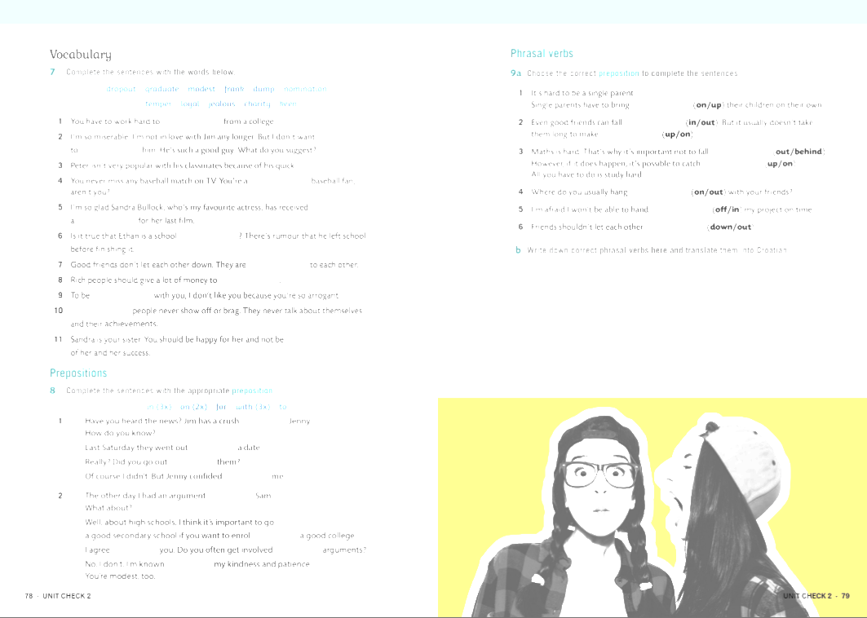
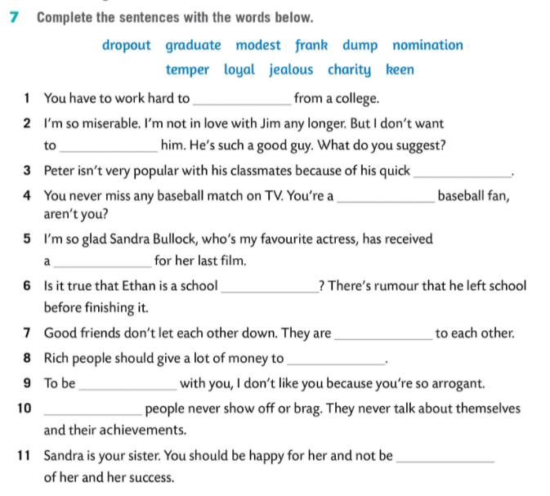
graduate
dump
temper
keen
nomination
dropout
loyal
charity
frank
Modest
jealous

Slide 3
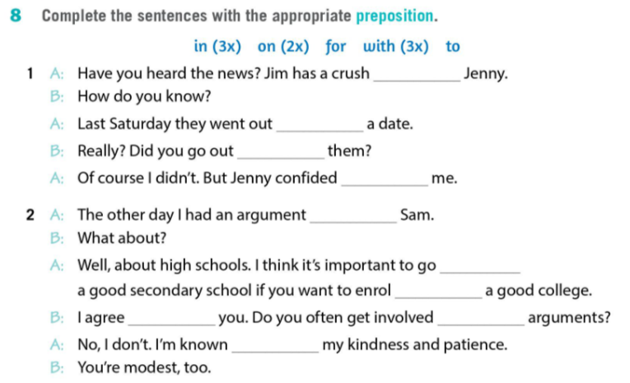
on
on
with
in
with
to
at
with
in
for

Slide 4
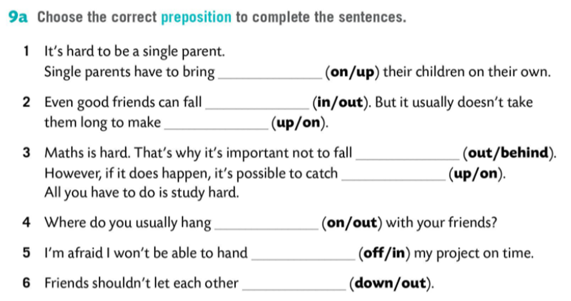

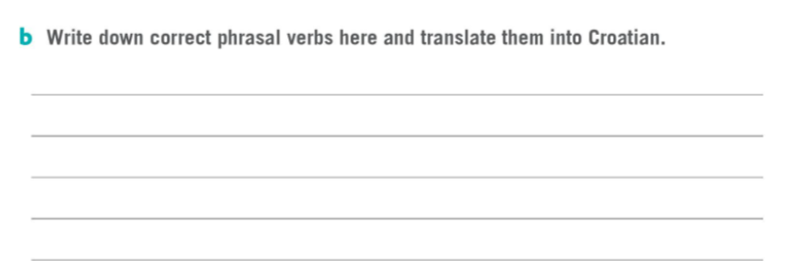
up
out
up
behind
up
out
in
down
bring up
podići, odgojiti
hang out
izlaziti
fall out
posvađati se
hand in
predati
make up
pomiriti se
let down
iznevjeriti
fall behind
zaostati
catch up
nadoknaditi

Slide 5
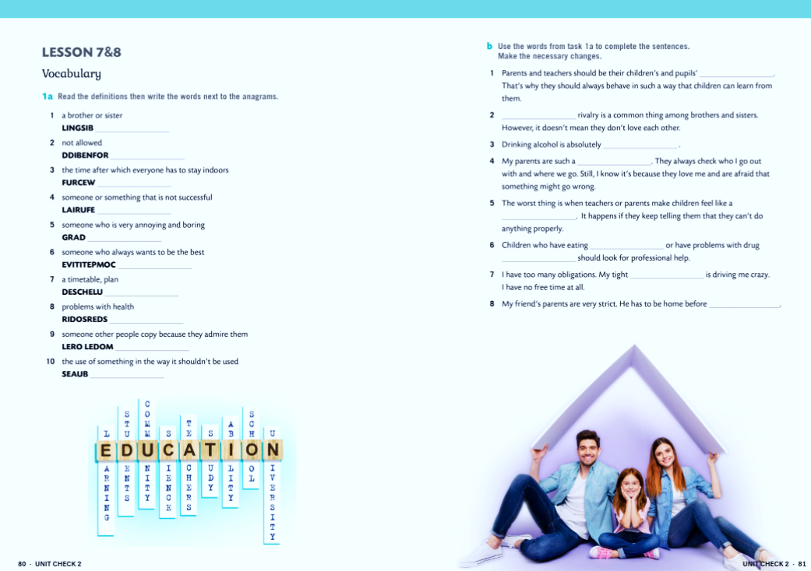
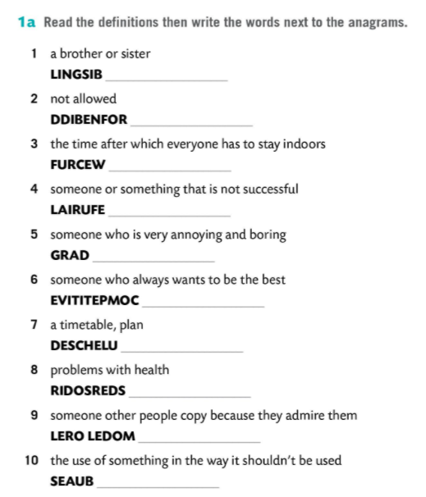

SIBLING
FORBIDDEN
CURFEW
FAILURE
DRAG
COMPETITIVE
SCHEDULE
DISORDER
ROLE MODEL
ABUSE

Slide 6
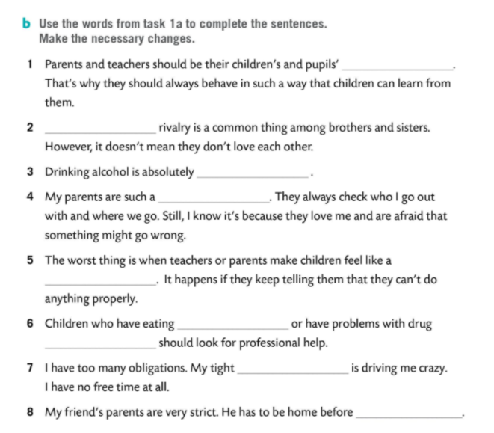

role models
Sibling
forbidden
drag
failure
disorders
abuse
schedule
curfew

Slide 7
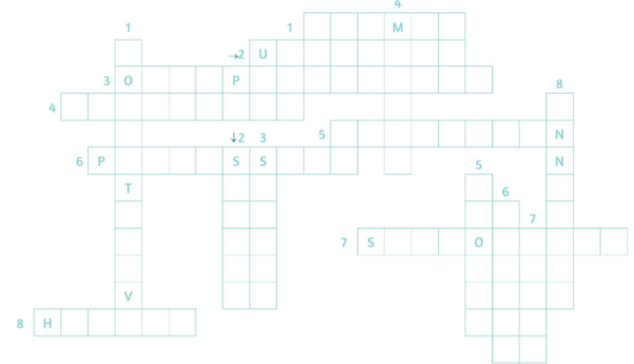

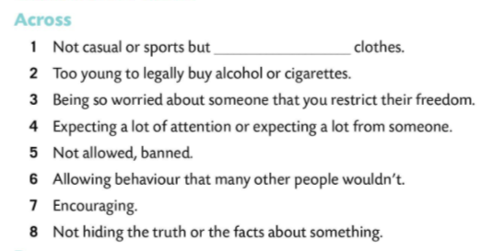
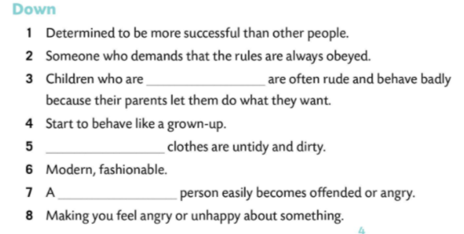

Slide 8
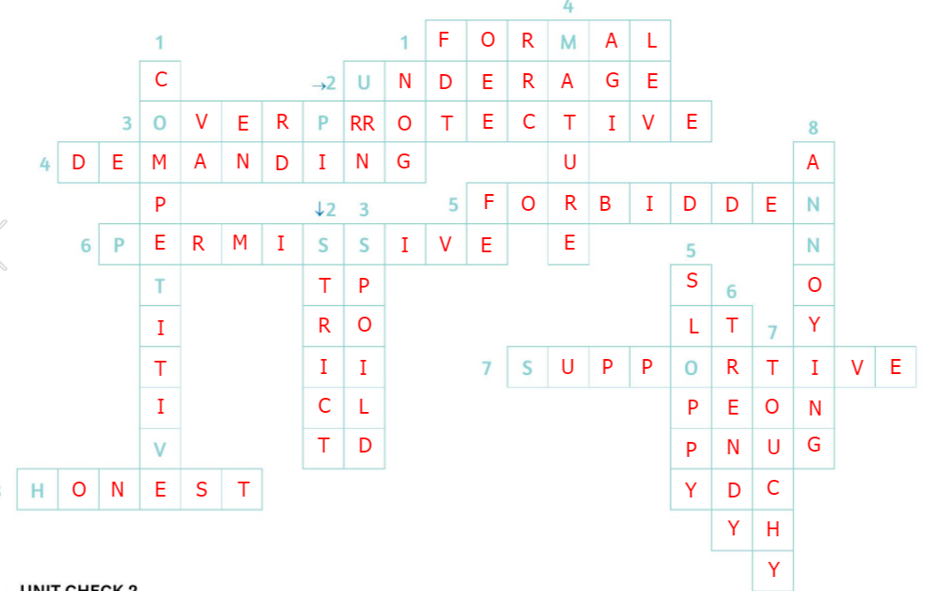

Slide 9
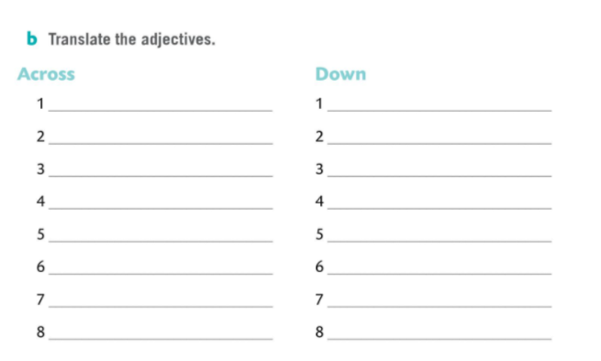
formal – služben, svečan
competitive – koji se želi natjecati
underage - maloljetan
strict - strog
overprotective – koji se ponaša previše zaštitnički
spoiled – razmažen
demanding - zahtjevan
mature - zreo
forbidden - zabranjen
sloppy - neuredan
permissive - popustljiv
trendy - moderan
supportive – koji pruža podršku
touchy - osjetljiv
honest – iskren, pošten
annoying – koji živcira

Slide 10
